Slide 1

Smile dental clinics Website Content

Slide 2
Home page Website Content

Slide 3
Home section
Use the same text.
The line of family will be with the old man photo.

Slide 4
Youtube
Change the headline:
Welcome to Smile Dental Clinic

Slide 5
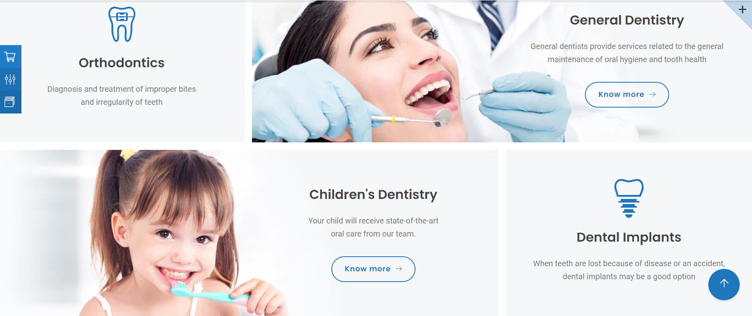
Categories section
Websites
1200 w x 400 h

Slide 6
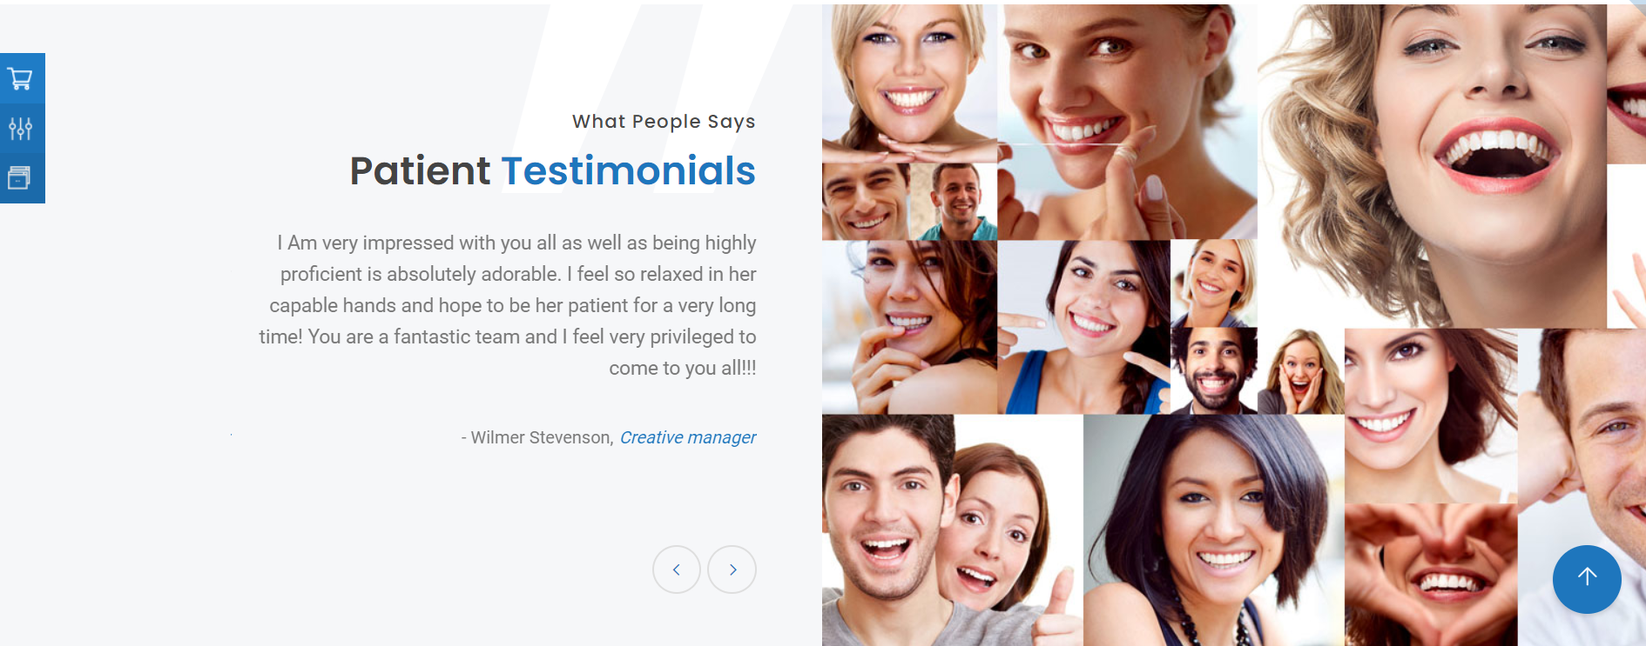
About
960 w x 610 h

Slide 7
Clinic Figures
3 Dentistry Specialists
1 Location

Slide 8
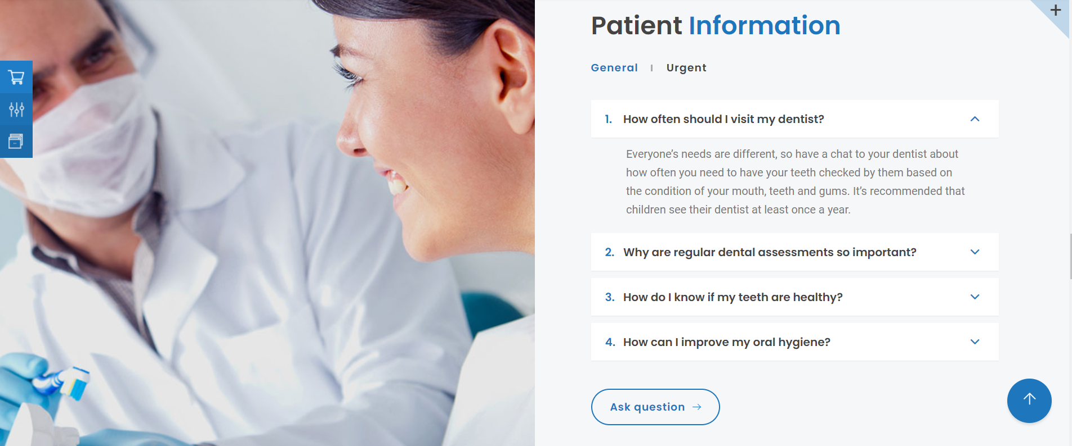
Patient information
960 w x 702 h

Slide 9

Contact section
650 w x 500 h
Phone number
19001

Slide 10
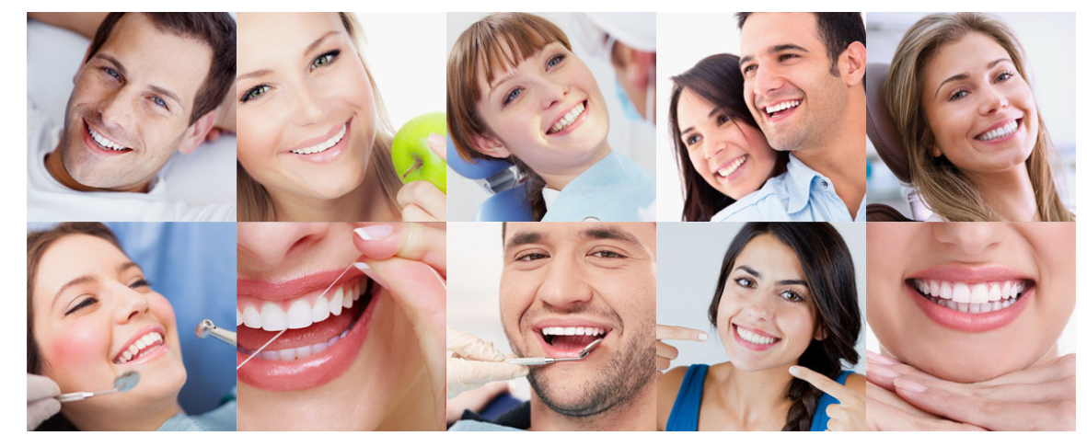
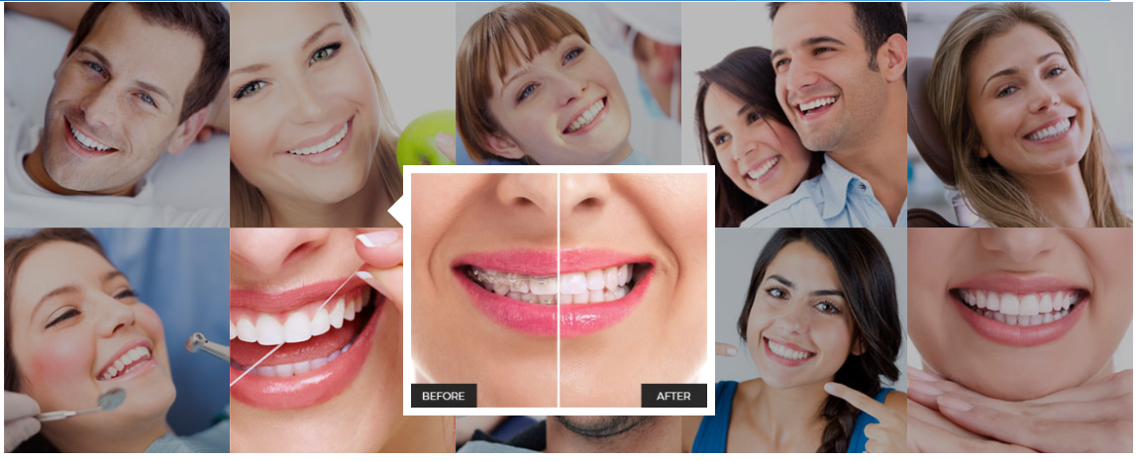
Smile section
1
2
3
4
5
6
7
8
9

Slide 11
Testominals page Website Content

Slide 12
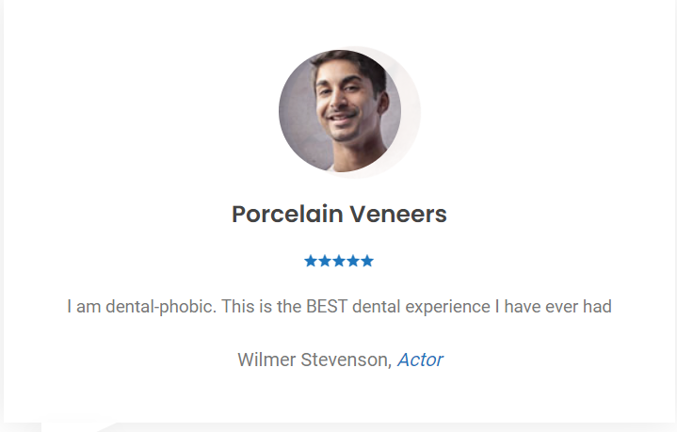
Images in review
Write any Arabic names & job titles

Slide 13
Doctors page Website Content

Slide 14
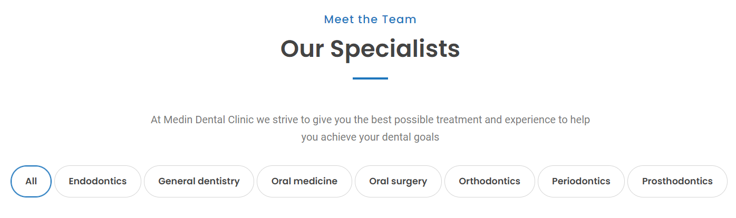
page
Dr. Fahim Bahgat
Associate Dentist
Dr. Basma Kamal
Dental Hygienist
Dr. Gehan Gamal
General Dentist
Dr. Fahem Bahgat has been in practice for almost 20 years graduating BDS from Cairo University,EG in 1997
Having graduated in 2005 with an R.D.H, Basma worked in and shared ownership of a very successful dental practice.
Gehan graduated from the Ain Shams University in 2004 being awarded the Dental Award in his final clinical year

Slide 15
About page Website Content

Slide 16

First section
For nearly 16 years, We have provided cosmetic dentistry as well as family dentistry services. Our dentists understand that patients have a variety of practices in the area to choose from.
Come and experience dentistry carried out a little differently in our Private Practice. A practice where you will:
Be involved in your care and treatment choices
Be welcomed and feel relaxed and cared for
Appreciate the well qualified, experienced team
Want the best dentistry available
Change the Big image only
Use the following content
It is our mission to exceed expectations by providing exceptional dental care to our patients and at the same time, building relationships of trust with them.
Our vision is to be one of the leading dental clinics in the area, expanding our services to reach additional community members. We work to be trusted by patients, valued partners in the community.

Slide 17
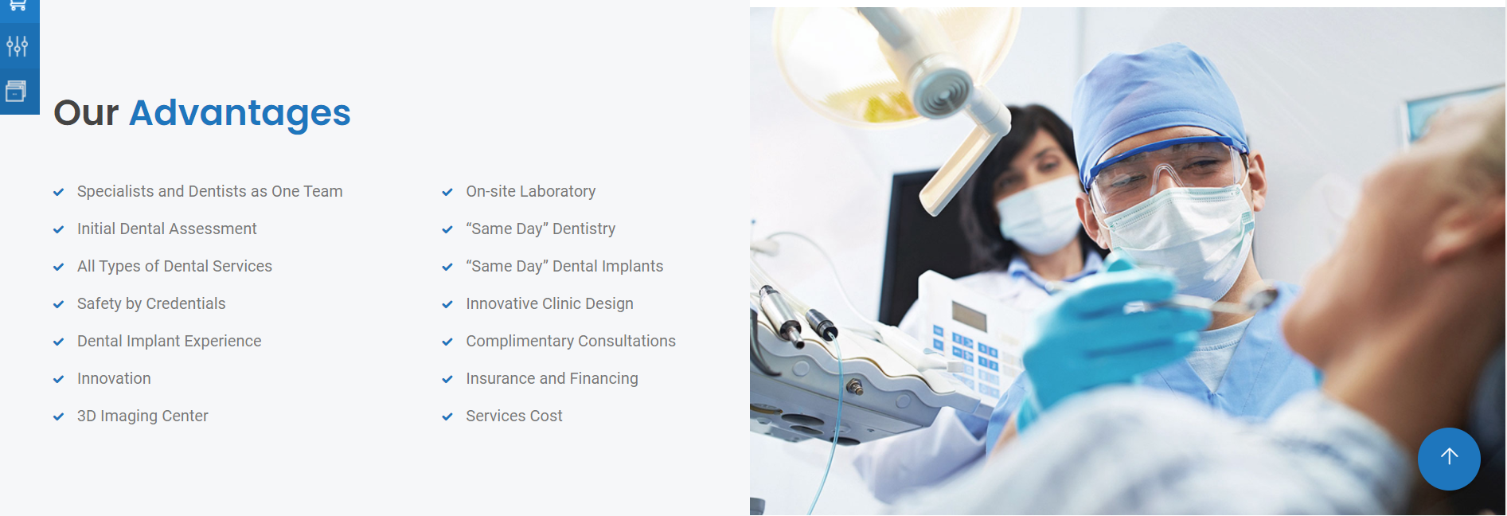
second section
image
1300 w x 950 h

Slide 18
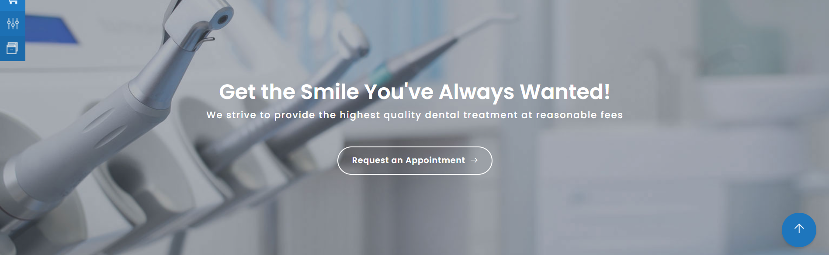
Third section
We will use the existing content
1600 w x 480 h

Slide 19
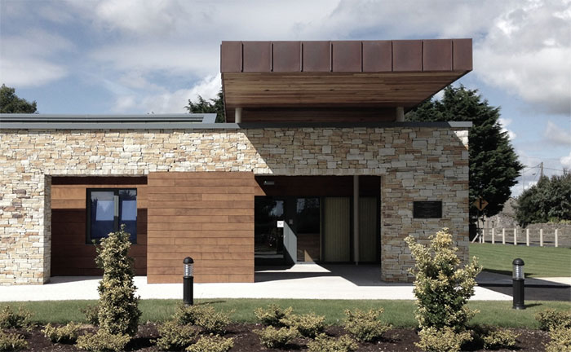
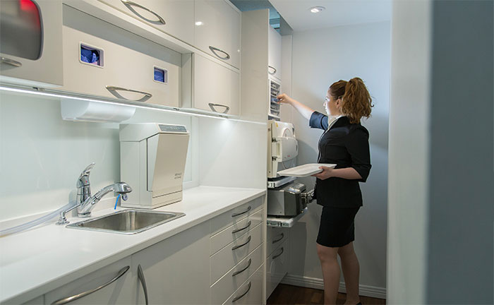
Fourth section
Remove the following phots and leave the rest

Slide 20
FooterWebsite Content

Slide 21
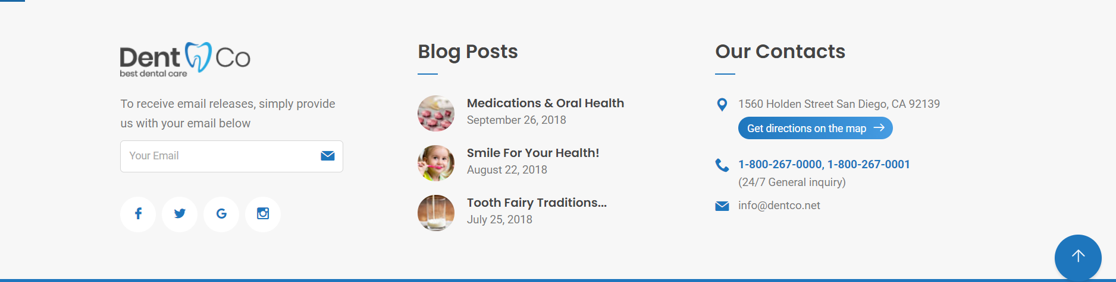
Footer
Address: N Teseen St, Cairo Governorate - Egypt
Phone: 19001
Email: Shiny@smiledentalclinic.com
We at Smile dental clinic are always fully focused on changing lives, One Smile At A Time! with great commitment and easy recovery.

Slide 22


